Slide 1


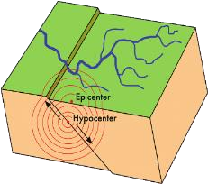




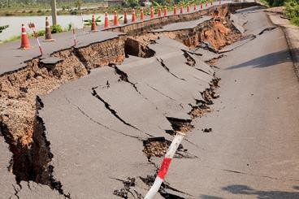
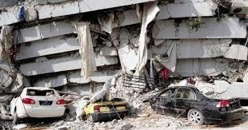

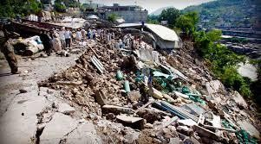
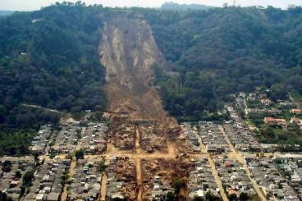









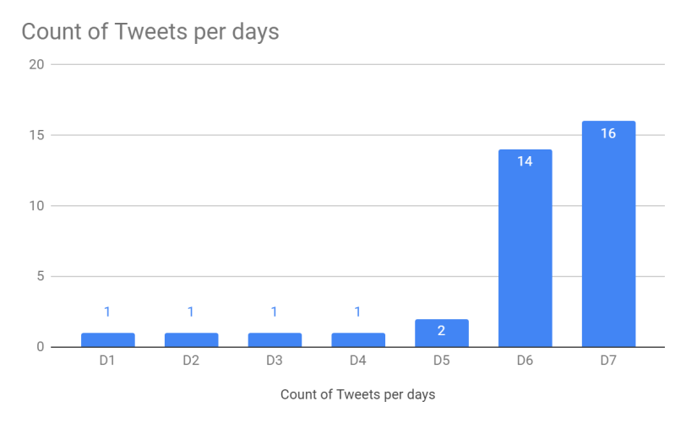




8TH OCTOBER 2005 EARTHQUAKE IN PAKISTAN
MSc Information technology, Social Media and Web Science, Student Id: 21012116
Introduction:
In early 21st century on 8th October 2005 nearly 8:50 AM the origin of earthquake was 19 km northwest of Muzaffarabad in region of Kashmir of Pakistan. Earthquake is the vibration of earth produced by the rapid release of energy. Earthquake cause the building damage is directly affected to the human life and loss of property. Due to earthquake, it may loss many lives as well as properties. It also affected the information on effected area, building collapse and rapid aid not able to be reached on time. So, it is impossible without expertise team member and many funding required when areas are affected, and roads are blocked.
Consequences of Earthquake:
Ground shaking: During earthquake, the ground vibrate which cause land sliding and liquefaction.
Surface rupture: It is the movement of ground vertical and horizontal called ruptured fault affect the large area and produce damage to road, building and pipeline.
Liquefaction: During earthquake, the loose soil turn into liquid.
Fires: During earthquake when earth shaking the gas pipeline and electrical lines dislodged which cause the fire.
Tsunamis: On Ocean floor the earthquake generate the very large wave which called tsunami. The ocean water travel from ocean to land and affect the human property.
Finding 2:
The 500,000 families are affected due to earthquake. The 250,000 animals died due to collapse of stone barns. The nearly 8 lac building were destroyed or damaged. Nearly above 16,500 government and private institutes were destroyed.
Finding 1:
The governments of Pakistan shared the data estimated that total casualty reach over the 87,350 and over 38000 were injured. And over 35 lac people rendered homeless. Apart from this, the adversely affected the roads and highway, landslides, bridge failures. The power supply, water supply, telecommunication surface ruptures
Methodology:
Data is collected from online platform which is Twitter, using the TAGSv6.1.9.1 and the TAG earthquake2005pakistan, data collected for a period of 1 week. Data collected manually filter by category such as related and non-related to the topic chart generated by google sheet about the tweet per day.
Conclusion:
In Pakistan Radio play an important role during the earthquake when telecommunication cable is disconnected, and roads were blocked. Awareness in public about the risk management should increases. The special building capacity and earthquake resistant design is required to build. It is necessary to introduce the effective communication among the stakeholders to avoid the damage in future. This also facilitated the victims and helped to resolve their problems. Which also help the government and agencies to relief to prompt action and help the affected people.
References:
The Kashmir earthquake of October 8, 2005: Impacts in Pakistan - Pakistan’ (2006) ReliefWeb.28 February 2006 [online]. Available from: https://reliefweb.int/report/pakistan/kashmir-earthquake-october-8-2005-impacts-pakistan [Accessed 14 May 2022]
The Editors of Encyclopedia Britannica (2019) Kashmir earthquake of 2005 Encyclopædia Britannica. [online]. Available from: https://www.britannica.com/event/Kashmir-earthquake-of-2005 [Accessed 14 May 2022].
Shah, I., Mahmood, T., Khan, S.A., Elahi, N., Shahnawaz, M., Dogar, A.A., Subhan, F. and Begum, K. (2022) Inter-agency Collaboration and Disaster Management: A Case Study of the 2005 Earthquake Disaster in Pakistan. Jàmbá: Journal of Disaster Risk Studies [online]. 14 (1) [Accessed 27 Jan 2022].

